Slide 1
LEGO train integration with Bluetooth/Python/MQTT and the WEB for train remote control
Remotely controlling a LEGO train over the web with ZOOM

Slide 2
What are we going to show?
Using a standard LEGO train package (described in more detail later in the deck) without any modifications and a standard default Raspberry Pi A+ (described later) we will demonstrate how to link these together via Bluetooth to replace the default LEGO Bluetooth controller that comes with the trainset and allow you to control your train via commands sent from the Pi using Python as a controlling language.
Extending this we will then show you how we have added a small PHP (recursive acronym for PHP: Hypertext Preprocessor) backend controller along with a small simple Angular web application (mainly used for the UI effects and for providing web based button controllers) to allow users from anywhere on the web to send the same commands using the MQTT (Message Queue Telemetry Transport) protocol (described in a little more detail later in this deck) back to the Rasp Pi A+ and therefore remotely control the LEGO train from anywhere in the world.
These components do use some 3 party libraries but these are Open source, as you will see this project is actually designed to be run external to the company.

Slide 3
A Little Background
Concept
This idea is a direct steal from the London IoT group who first of all did this as a very successful demo using a Duplo train back in 2017/18 for Ignite week.
They shared out over zoom and had parent and child groups controlling the train all over the UK
We want to do the same internally to JP and possibly externally with schools
Opportunities to encourage adults into considering computing and IT as a career
Technologies used
Bluetooth
Bluetooth is a short-range wireless technology standard that is used for exchanging data between fixed and mobile devices over short distances using UHF radio waves. Here we are using Bluetooth Low Energy (BLE) 4.2. Physical range is typically less than 10 m (33 ft). See https://en.wikipedia.org/wiki/Bluetooth
MQTT
MQTT (Message Queue Telemetry Transport) is a lightweight, publish-subscribe network protocol that transports messages between devices. The protocol usually runs over TCP/IP. Here we are using it over the internet with a UK public broker. Some more detail will be supplied in a later slide. See https://en.wikipedia.org/wiki/MQTT

Slide 4
Some more technical detail
LEGO Train (Most important component)
We (Glasgow STEM group) bought a LEGO 60197 City Train set from Amazon which contained the train, 2 carriages, some track, a platform, some minifigs and a signal. We had to supplement with some more boxes of LEGO 60205 City track to make a decent layout. But you can never have enough track for a train layout. The train spec can be found here: https://www.amazon.co.uk/LEGO-60197-Passenger-Train-Construction/dp/B078K44BP8/ref=pd_bxgy_img_2/258-0559402-8426338?pd_rd_w=41B0H&pf_rd_p=c7ea61ca-7168-47e3-9c8b-d84748f5b23c&pf_rd_r=JQPE3P5DZ81K3M2GKK4W&pd_rd_r=b1bb1b41-11ae-4ec4-a20b-ceac126bb2c4&pd_rd_wg=l43NR&pd_rd_i=B078K44BP8&psc=1
We also bought a Raspberry Pi Model A+ as we needed the power but didn’t need multiple USB ports or a Network port. The spec for this can be found here: https://www.raspberrypi.com/products/raspberry-pi-3-model-a-plus/
We also invested in an external website hosted somewhere down near London. Running costs are something like £5 a month, and I leave it as an exercise for the deployer to find a cheaper alternative. We host a shared website on this as cheap as possible.

Slide 5
The messaging protocol
Some more details of MQTT
Originally Message Queuing Telemetry Transport but since 2013 MQTT does not stand for anything and just refers to the protocol
The protocol usually runs over TCP/IP and this is where we are using it across the internet in this case with a standard set of libraries.
The protocol defines two types of network entities: a message broker and a number of clients. An MQTT broker is a server that receives all messages from the clients and then routes the messages to the appropriate destination clients. An MQTT client is any device (from a micro controller up to a fully-fledged server) that runs an MQTT library and connects to an MQTT broker over a network.
Normally used in its default mode of publish/subscribe, where one client will publish a message to a ‘topic’ on a broker and one or more clients will subscribe to that ‘topic’ to receive all of the messages sent to a topic.
In this project we are using a client based in the Raspberry Pi running a Python Library to receive messages and a second client based in the web client using a PHP library. We are using the standard UK broker HiveMq at http://www.mqtt-dashboard.com/ to handle our topic and messages. A full discussion on MQTT protocol and the Publish/subscribe mechanism is really beyond this talk and details can be found in the Wikipedia article on Slide 3 or can be talked about during Q&A.
HiveMQ is commercial but free up to a limit of messages though unprotected so messages are visible to all. There is no security implemented in this project. However, the messages transmitted are very simple.

Slide 6
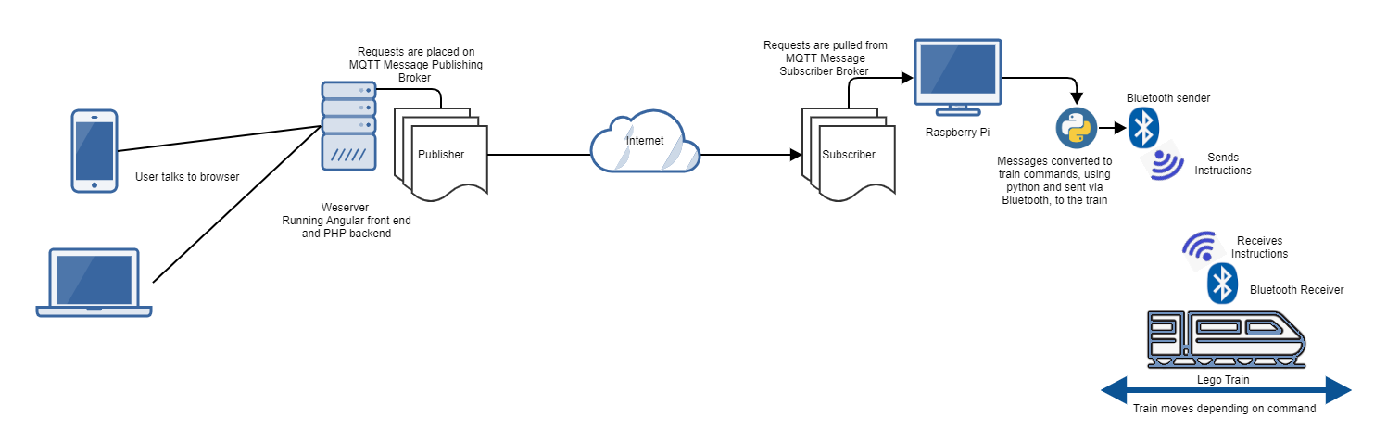
So How does a message flow through the Application?

Slide 7
Architecture overview
Internet
Client
MQTT
Broker
Raspberry Pi or PC
Train

Slide 8
Architecture overview
Internet
Client
MQTT
Topic: dlr
Raspberry Pi
Subscribe
Train
Low Energy Bluetooth

Slide 9
Internet
Client
MQTT
Subscribe
Topic: dlr
Raspberry Pi
Subscribe
Train
Low Energy Bluetooth

Slide 10
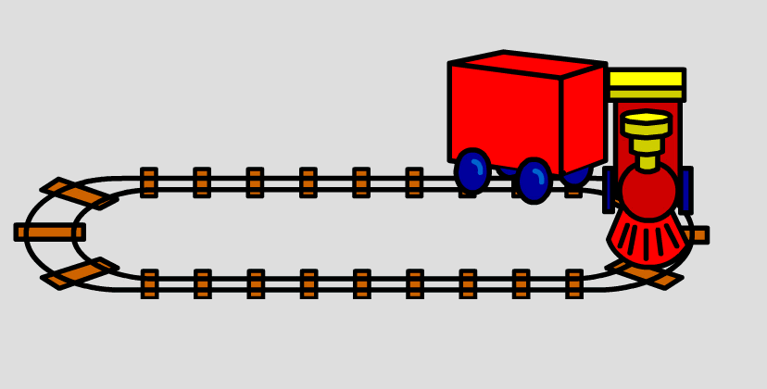
Architecture overview
Internet
Client
MQTT
Subscribe
Publish
Topic: dlr
Send Msg: Go
Raspberry Pi
Subscribe
Publish
Train

Slide 11
Internet
Client
MQTT
Subscribe
Publish
Topic: dlr
Publish
Raspberry Pi
Subscribe
Publish
Publish
Send Msg: Speed 50
Train

Slide 12
Architecture overview
Internet
Client
MQTT
Subscribe
Publish
Topic: dlr
Publish
Raspberry Pi
Subscribe
Publish
Publish
Train
Low Energy Bluetooth

